Slide 1


Health boost+
Team STA:
Neagu Alexandra-Codruta
Amzuloiu Teodor
Amzuloiu Sergiu

Slide 2



Agenda
Introduction
Categories
Bad Habits
Mood
Suggestions
Conclusion

Slide 3




Introduction

Slide 4
sections
Bad Habbits
Mood
Suggestions

Slide 5
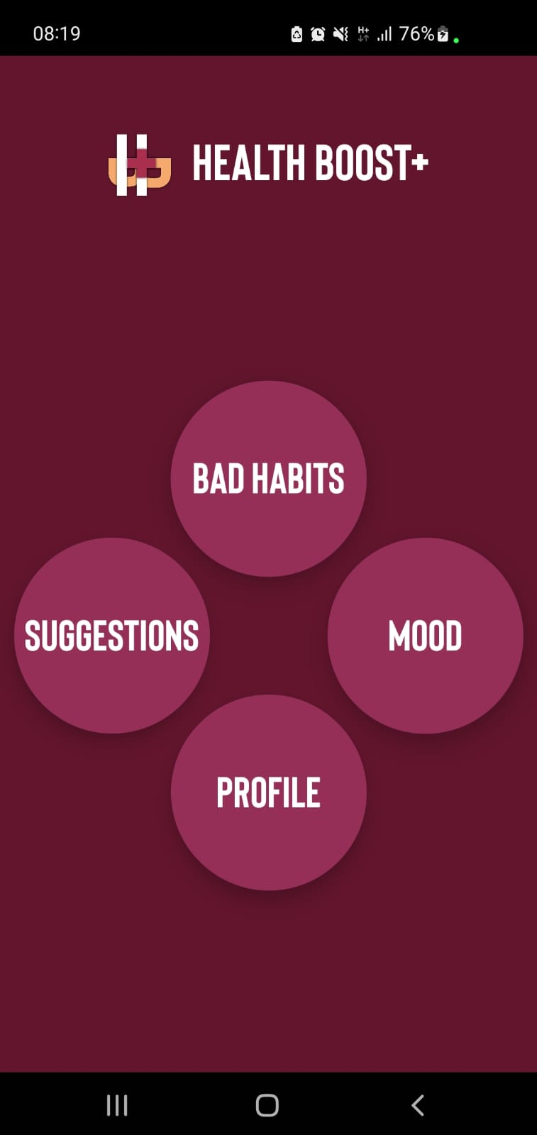



Sections
Watch

Slide 6
Bad Habits

Slide 7
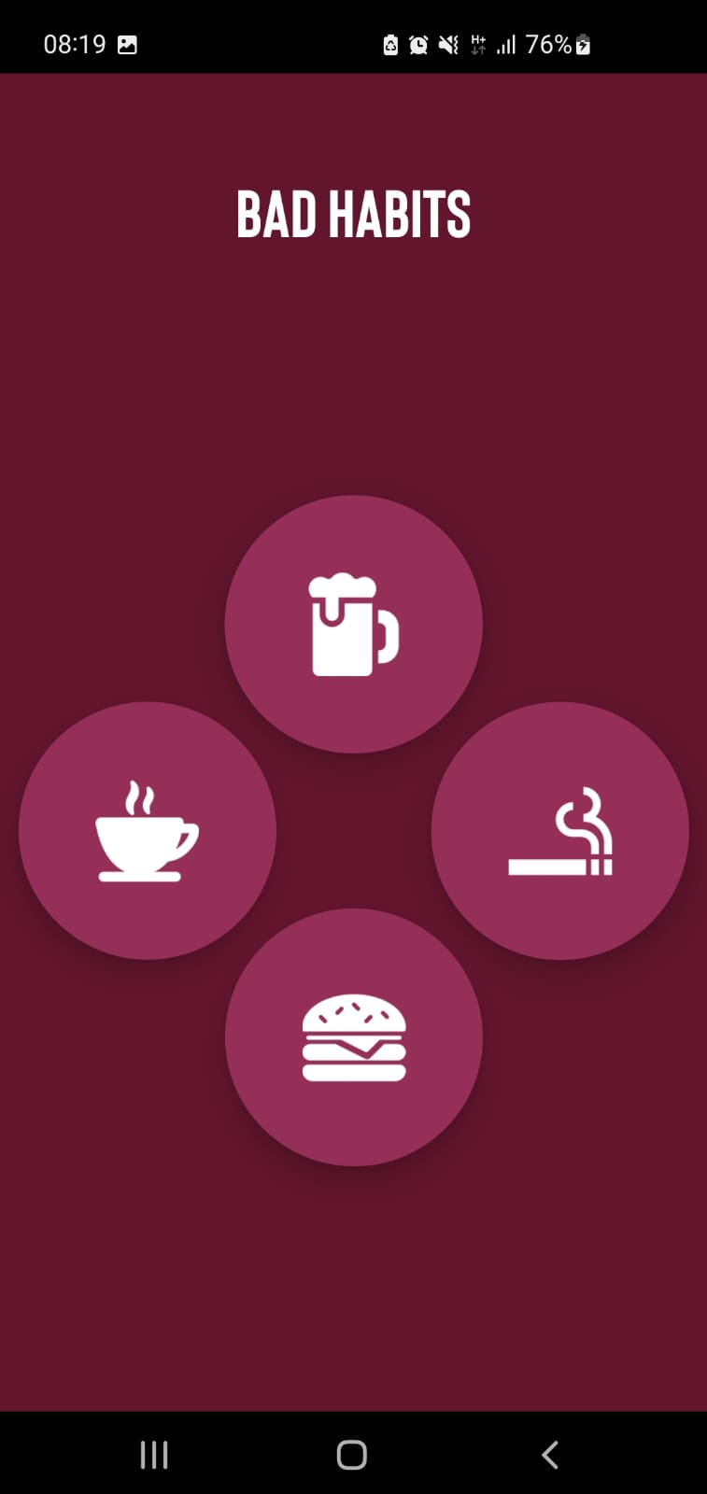


Bad Habits
Watch

Slide 8

Bad Habits
https://www.smokefreestjoe.org/smoking-costs-in-the-workplace/

Slide 9
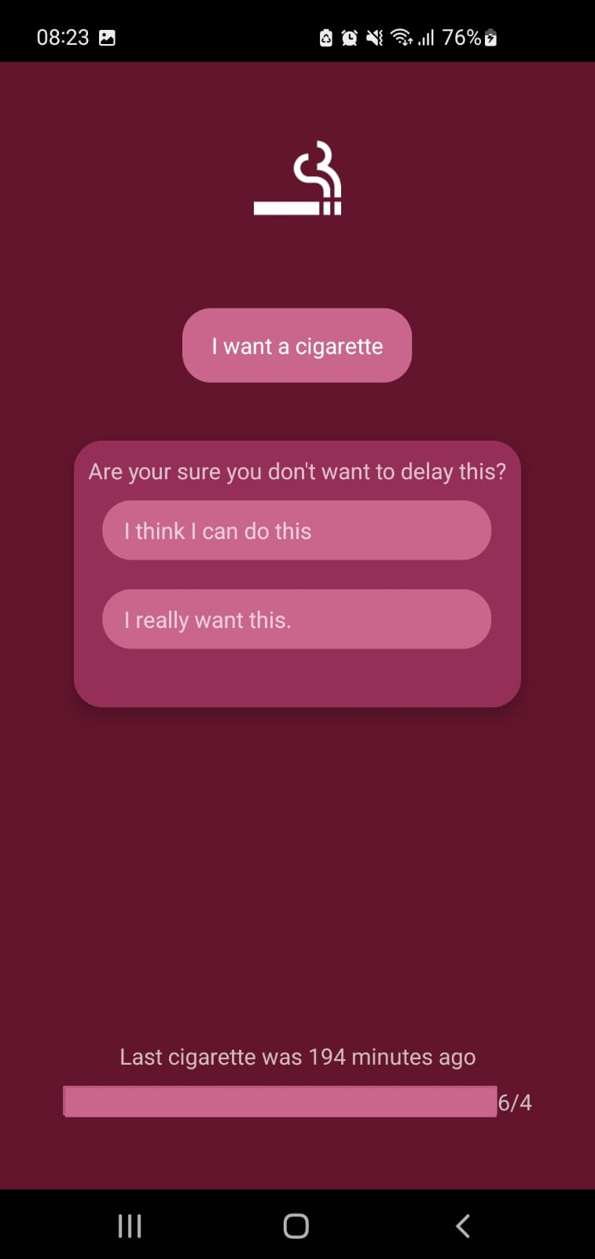
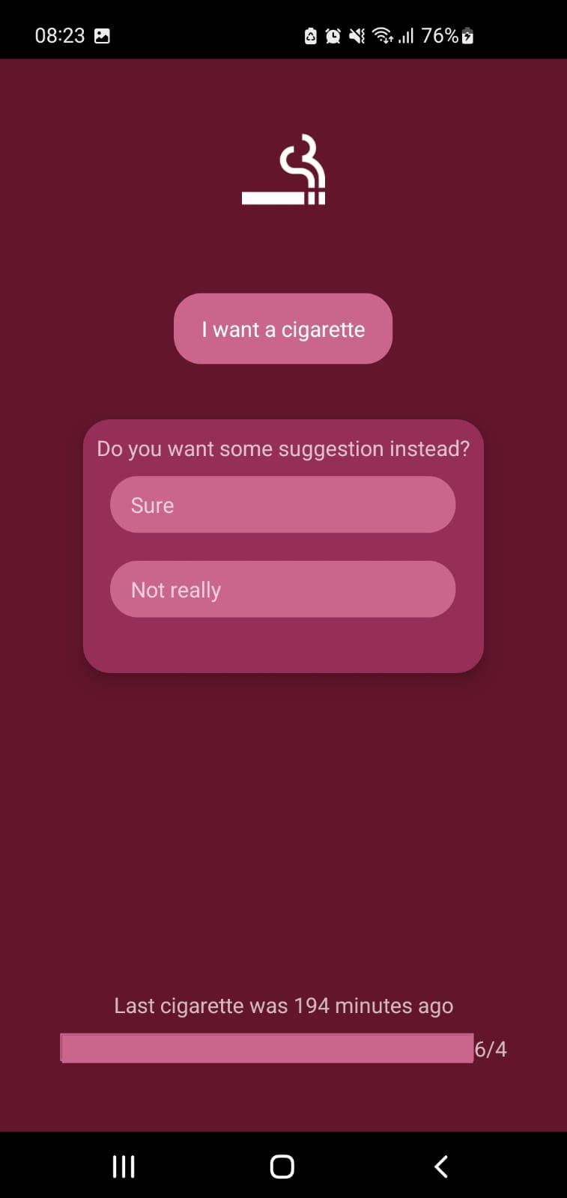
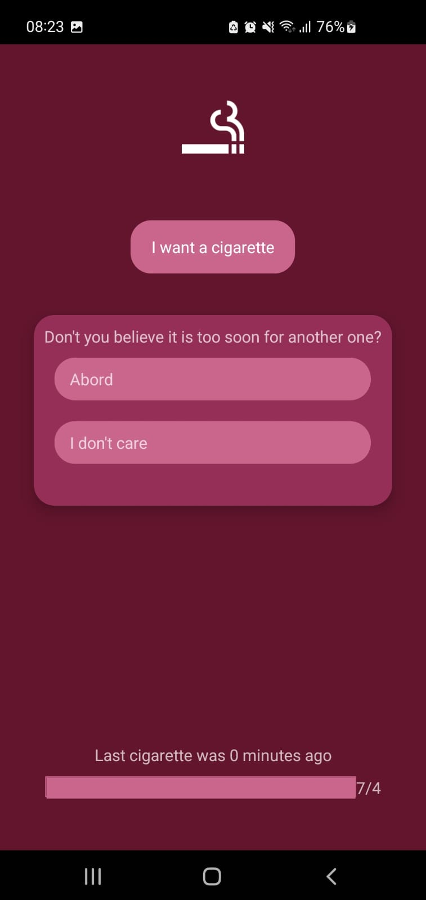
Bad Habits

Slide 10
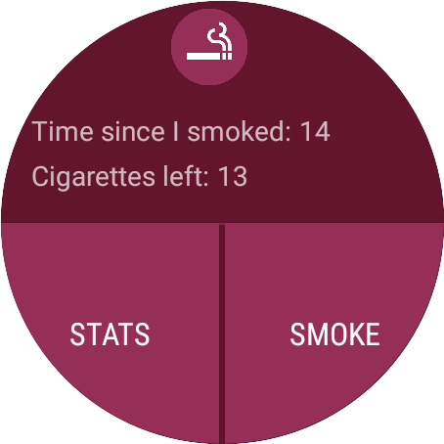
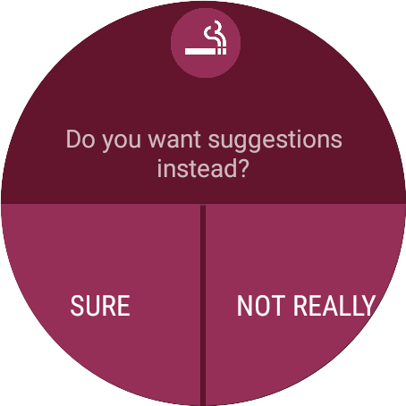


Bad Habits

Slide 11
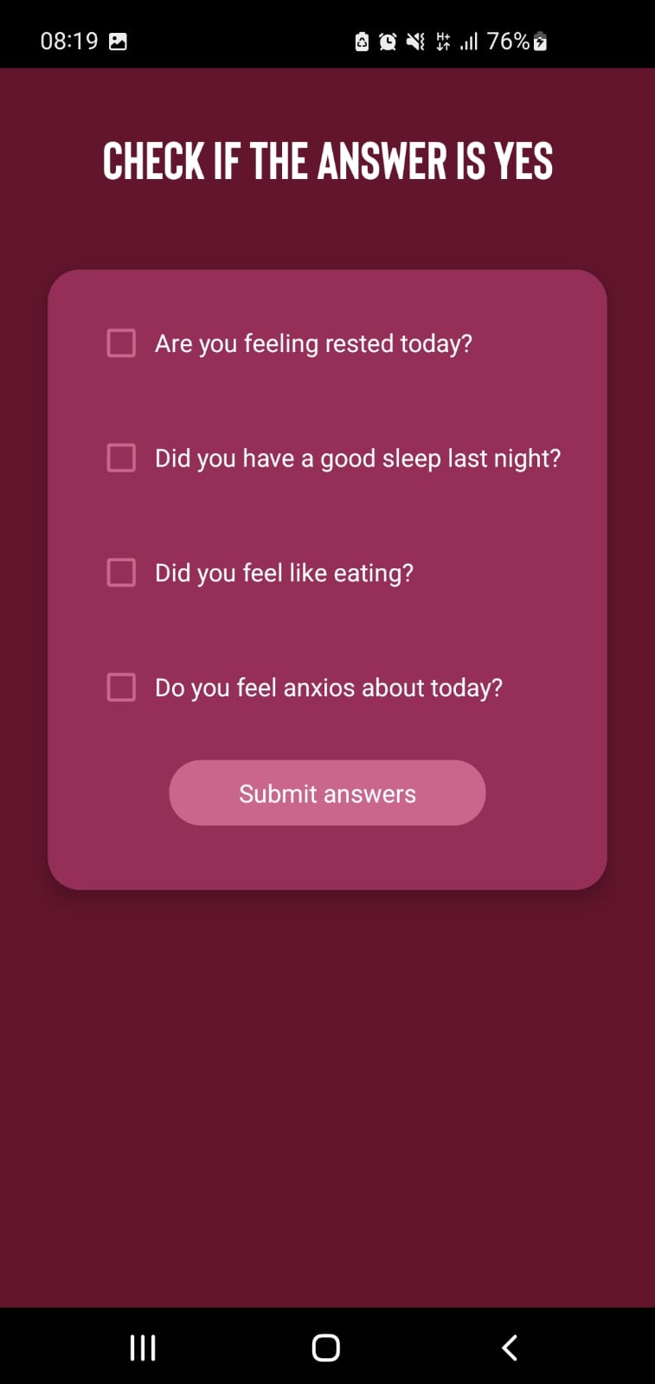

Mood

Slide 12
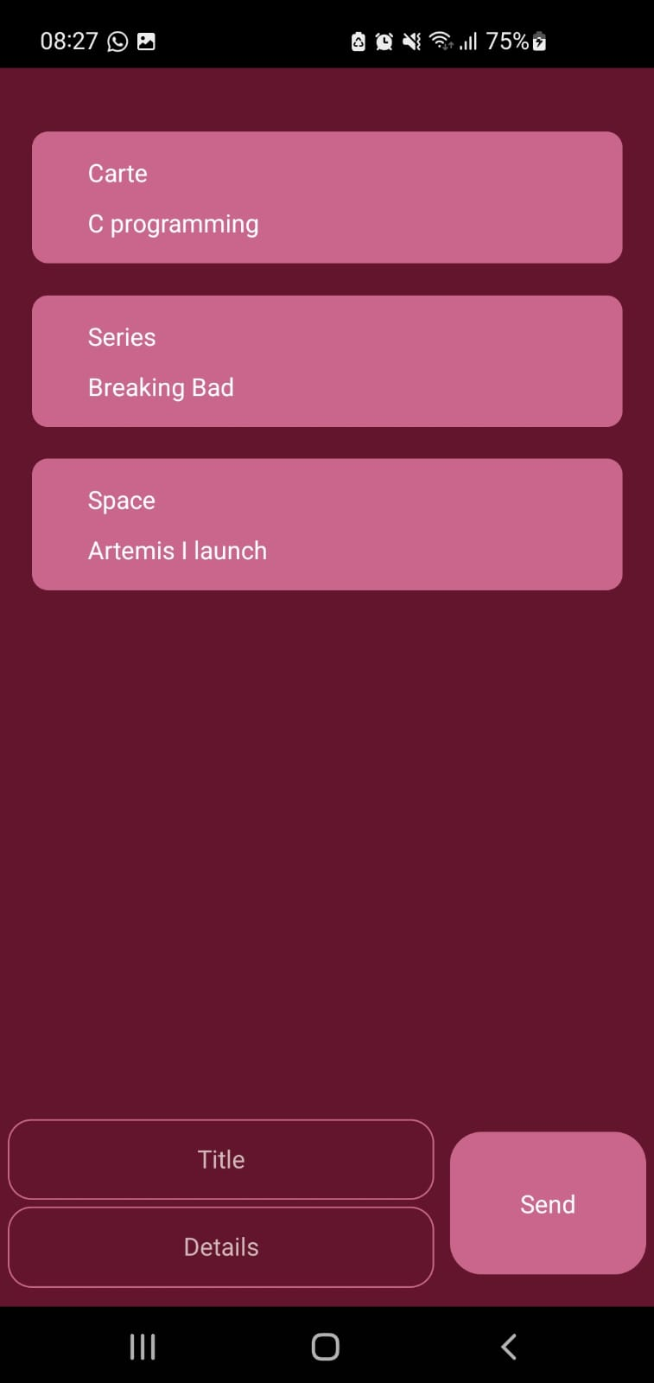
Suggestions

Slide 13
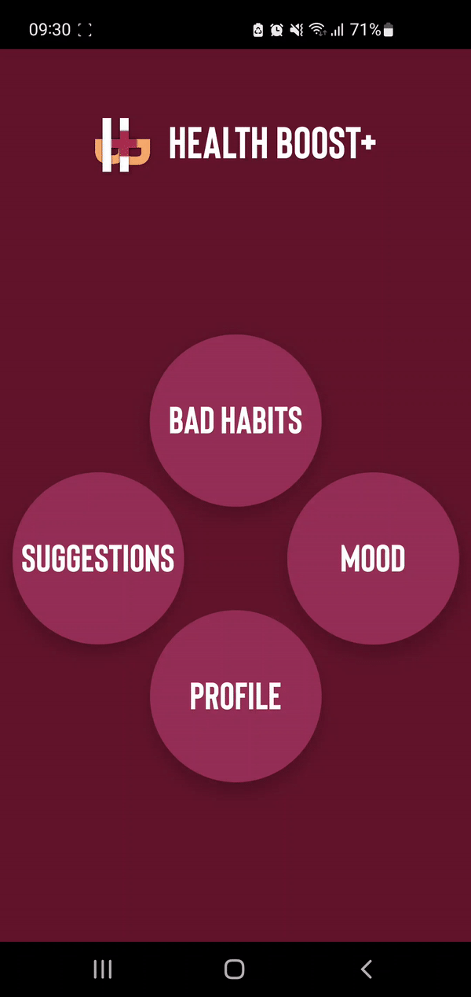

Conclusion

Slide 14
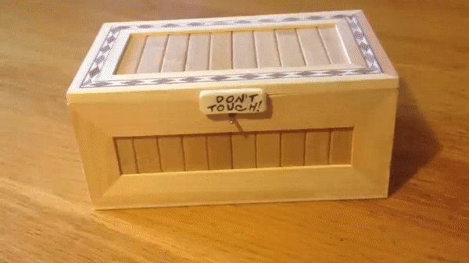
Thank you!

